Slide 1
Applied Physics and Electronics
Lecture 1
Presented by: Muhammad Farooq

Slide 2
Study Material
Electronic Principles by Albert Paul Malvino (7th Edition)
Electronic Devices and Circuits Theory by Robert L. Boylestad (9th Ed)
And don’t forgot to browse internet for any topic
These slides will be available after every lecture

Slide 3
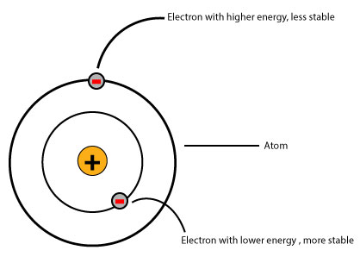
Introduction: Concepts of Electricity
Electricity is movement of Electrons
What is an Electron?
a stable subatomic particle with a charge of
negative electricity, found in all atoms
Every material has different number of
electrons
These electrons causes charge

Slide 4
Concepts of Electricity contd.
Electric Charge is the property of subatomic particles that causes it to experience a force when placed in an electromagnetic field
It can be negative or positive
Electrons carry negative charge and Protons carry positive charge
Three basic principles which are important in electricity are
Voltage
Current
Resistance

Slide 5
Concepts of Electricity contd.
Voltage: it can be defined as, it is the difference in charge between two points
It means one point has more charge than other
Unit of voltage is Volts
It can be AC or DC
Common example of voltage sources is battery cells which are available in market

Slide 6
Concepts of Electricity contd.
Current: The amount of charge flowing through a conductor in a given time is called current
Unit of current is Ampere which can be defined as one coulomb charge flowing in one second
Symbol for representation of current is “I”

Slide 7
Concepts of Electricity contd.
Resistance: Resistance is a measure of the opposition to current flow in an electrical circuit
Unit of Resistance is Ohm and can be described as when a constant potential difference of one volt, applied to two points, produces in the conductor a current of one ampere
Symbol of resistance is “R”

Slide 8
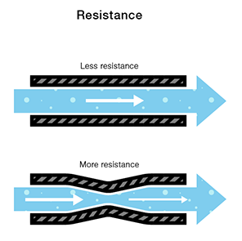
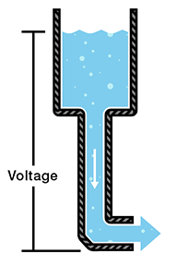

Concepts of Electricity contd.
All these three principles are well explained via water tank philosophy

Slide 9
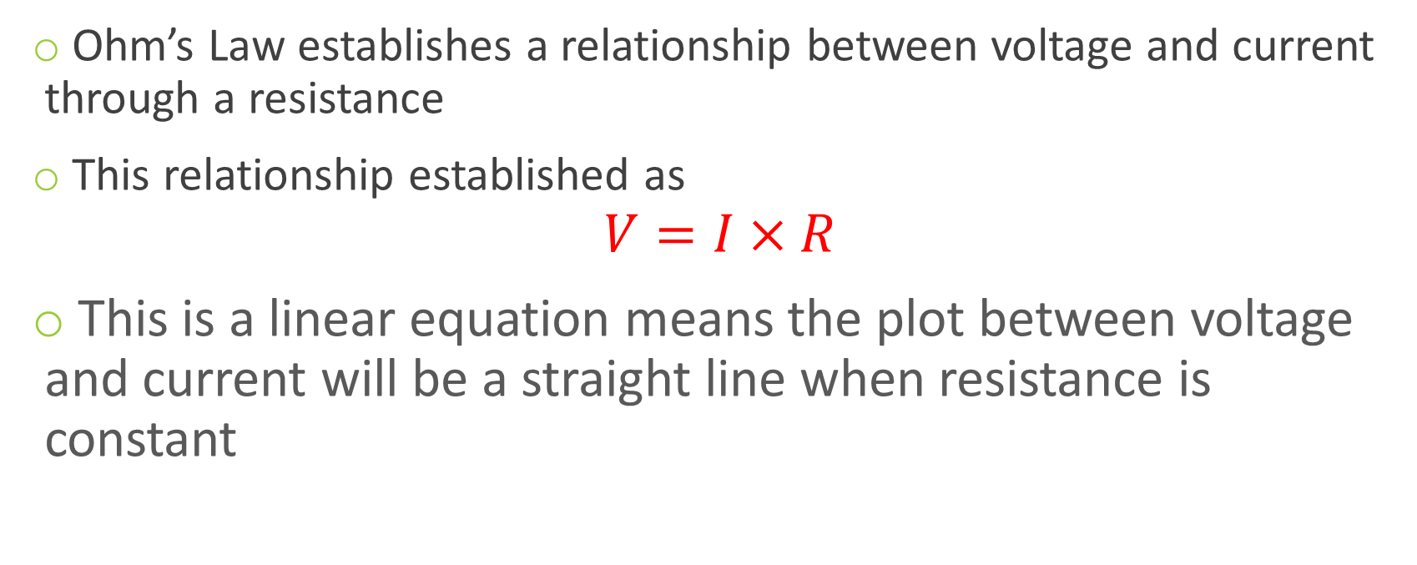
Ohm’s Law
Ohm’s Law establishes a relationship between voltage and current through a resistance
This relationship established as
$$V=I×R$$
This is a linear equation means the plot between voltage and current will be a straight line when resistance is constant

Slide 10
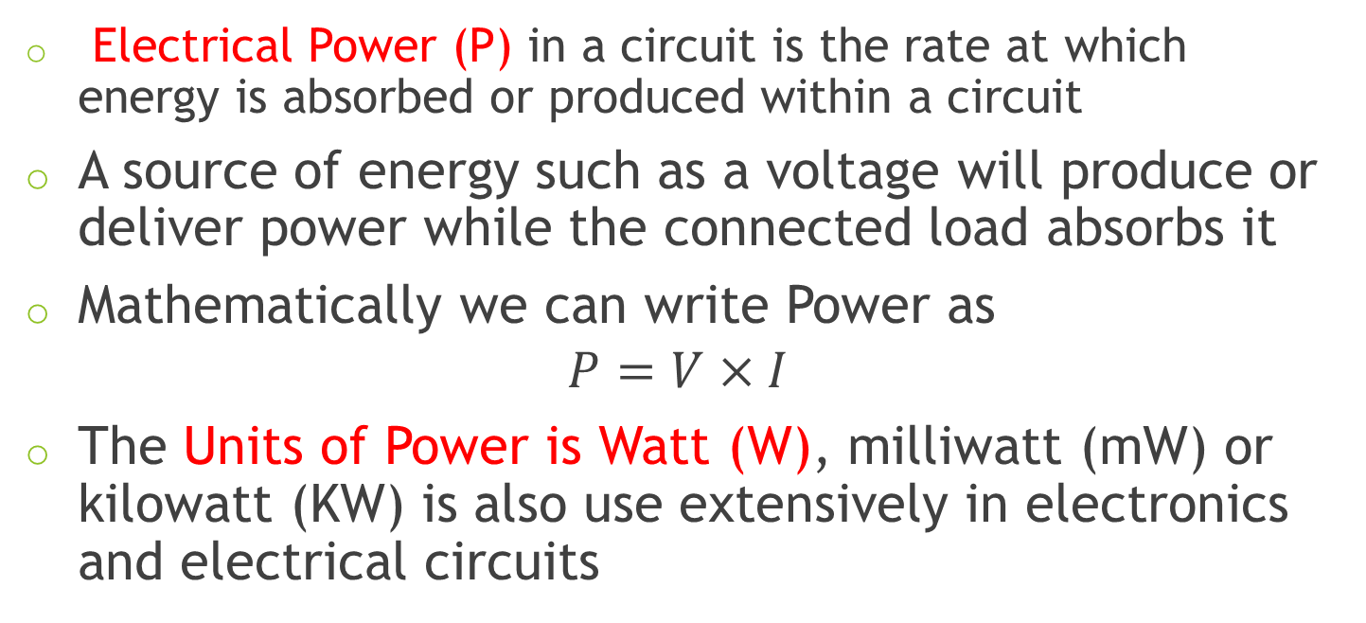
Ohm’s Law contd.
Electrical Power (P) in a circuit is the rate at which energy is absorbed or produced within a circuit
A source of energy such as a voltage will produce or deliver power while the connected load absorbs it
Mathematically we can write Power as
$$P=V×I$$
The Units of Power is Watt (W), milliwatt (mW) or kilowatt (KW) is also use extensively in electronics and electrical circuits

Slide 11
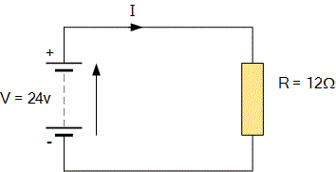
Ohm’s Law contd.
For the circuit shown below find the Voltage (V), the Current (I), the Resistance (R) and the Power (P)

Slide 12
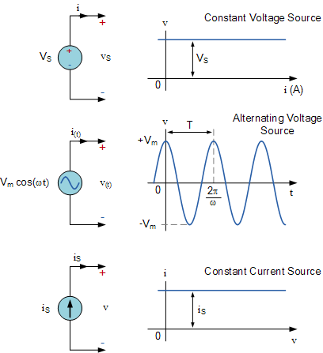
Voltage and Current Sources

Slide 13
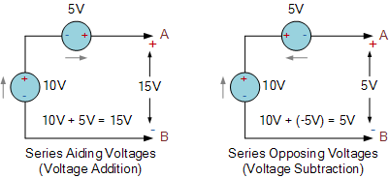
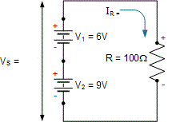
Voltage and Current Sources contd.

Slide 14
Applied Physics and Electronics
Presented by: Muhammad Farooq

Slide 15
Study Material
Electronic Principles by Albert Paul Malvino (7th Edition)
Electronic Devices and Circuits Theory by Robert L. Boylestad (9th Ed)
And don’t forgot to browse internet for any topic
These slides will be available after every lecture

Slide 16
Introduction: Concepts of Electricity
Electricity is movement of Electrons
What is an Electron?
a stable subatomic particle with a charge of
negative electricity, found in all atoms
Every material has different number of
electrons
These electrons causes charge

Slide 17
Concepts of Electricity contd.
Electric Charge is the property of subatomic particles that causes it to experience a force when placed in an electromagnetic field
It can be negative or positive
Electrons carry negative charge and Protons carry positive charge
Three basic principles which are important in electricity are
Voltage
Current
Resistance

Slide 18
Concepts of Electricity contd.
Voltage: it can be defined as, it is the difference in charge between two points
It means one point has more charge than other
Unit of voltage is Volts
It can be AC or DC
Common example of voltage sources is battery cells which are available in market

Slide 19
Concepts of Electricity contd.
Current: The amount of charge flowing through a conductor in a given time is called current
Unit of current is Ampere which can be defined as one coulomb charge flowing in one second
Symbol for representation of current is “I”

Slide 20
Concepts of Electricity contd.
Resistance: Resistance is a measure of the opposition to current flow in an electrical circuit
Unit of Resistance is Ohm and can be described as when a constant potential difference of one volt, applied to two points, produces in the conductor a current of one ampere
Symbol of resistance is “R”

Slide 21
Concepts of Electricity contd.
All these three principles are well explained via water tank philosophy

Slide 22
Ohm’s Law
Ohm’s Law establishes a relationship between voltage and current through a resistance
This relationship established as
$$V=I×R$$
This is a linear equation means the plot between voltage and current will be a straight line when resistance is constant

Slide 23
Ohm’s Law contd.
Electrical Power (P) in a circuit is the rate at which energy is absorbed or produced within a circuit
A source of energy such as a voltage will produce or deliver power while the connected load absorbs it
Mathematically we can write Power as
$$P=V×I$$
The Units of Power is Watt (W), milliwatt (mW) or kilowatt (KW) is also use extensively in electronics and electrical circuits

Slide 24
Ohm’s Law contd.
For the circuit shown below find the Voltage (V), the Current (I), the Resistance (R) and the Power (P)

Slide 25
Voltage and Current Sources

Slide 26
Voltage and Current Sources contd.

